Slide 1
New Fiscal Relationship with First Nations: 10-Year Grants
Presentation for Webinar
January 2019

Slide 2
Purpose
Reflect the journey to date on the new fiscal relationship with First Nations
Provide up-to-date information on the 10-Year Grant for First Nations, including:
Key benefits of the 10-Year Grant
Programs included
Funding level
Reporting requirements
Next steps for the eligible First Nations and those that are working towards meeting eligibility requirements

Slide 3
New Fiscal Relationship with First Nations: journey so far
July 2016 – Memorandum of Understanding with the Assembly of First Nations
2016-17 – Co-development and regional engagement
December 2017 – Final Report under the MOU
Recommendations accepted by AFN Chiefs-in-Assembly
Ministerial response sets priorities for implementation:
10 year grants for qualified First Nations
Default prevention reform
Advisory body to support ongoing co-development
Summer/Fall 2018 –
Outreach sessions on the 10-Year Grant
Eligibility reviews completed by First Nations Financial Management Board for Indigenous Services Canada
Winter 2019 – Offer 10-Year Grant to First Nations and Funding Agreements

Slide 4
Key benefits of the 10-Year Grant
The 10-Year Grant is a funding mechanism that will enhance self-determination by providing greater predictability and flexibility for First Nation governments to design and deliver services that address local needs and priorities.
What this means:
Funding agreements up to 10 years: Greater predictability to support long-term goals - most contribution agreements have terms of less than 10 years.
Grant with no program Terms and Conditions: Enhanced flexibility in the designing and delivery of services to the community:
First Nations will no longer be restricted by how Canada defines services through its Program’s Terms and Conditions. With the 10-Year Grant, First Nations have full control over the design and delivery of services funded through the grant;
Greater flexibility in allocating funding to better accommodate local needs without permissions from the department, including up-front single annual installments;
Stacking approach ensures no clawbacks or restrictions where First Nations raise funds from other government sources; and
Unrestricted ability to retain unexpended funds at year-end.
Reduced administrative burden - 90% reduction in data elements provided to Canada
Accountability to First Nation citizens - 10-Year Grant prioritizes reporting to citizens
No recipient audits - No recipient audits initiated by the department for programs included in the 10-Year Grant.

Slide 5
10-Year Grant and other funding mechanisms at a glance
Set/Fixed/Flex
Block
10 Year Grant
Short-term funding horizons, annual formula-driven adjustments
5-year term for non-health programs
10-year term for health programs
10-year grant funding horizon available at First Nation’s request
Predictability
Activities subject to terms and conditions of individual programs
Activities subject to terms and conditions of individual programs
Full freedom to design programs and services based on community priorities.
Program terms and conditions not applied or enforced.
Program design
Set: Minimal ability to reallocate funding, no carryover
Fixed and Flex: some provisions to reallocate funding (less than with Block), and to carry over
Reallocation across block programs and retention of unspent funds at year end subject to some restrictions and permissions from the department.
Full freedom to reallocate without permissions from the department.
Full freedom to retain unexpended funds each year.
Funding flexibility
Quarterly, monthly or other installment approach
Quarterly, monthly or other installment approach
Annual lump sum payments available at First Nation’s request
Payment Schedules
Access to funding mechanisms based on departmental risk assessment
Available to low-risk recipients only as measured by the General Assessment
Co-developed eligibility criteria
Advice on eligibility by a First Nations-led non-government institution
Eligibility
Program-specific restrictions on eligible expenditures apply
Restrictions on eligible expenditures related to multi-program objectives within the block
No tracking or compliance reviews of expenditures by ISC
No recipient audits
No stacking restrictions
Departmental Oversight
Primary focus is on outputs, reporting to Canada
Focus on compliance with program and funding agreement terms and conditions
Primary focus is on outputs, reporting to Canada
Focus on compliance with program and funding agreement terms and conditions
Focus on outcomes, reporting to citizens
Reporting to First Nation citizens supported by Financial administration laws/bylaws
90% reduction in required data fields to department
Reporting and Accountability
Continued application of Default Prevention and Management Policy until new Policy on Essential Services is fully co-developed
Continued application of Default Prevention and Management Policy until new Policy on Essential Services is fully co-developed
Default Prevention and Management Policy does not apply
No intervention by the department
Emphasis on collaborative approaches to maintain eligibility, ensure health and safety
Risk mitigation

Slide 6
What goes in the 10-Year Grant?
What goes in the Grant
Governance
Band Support Funding
Employee Benefits
Infrastructure: Capital Facilities and Maintenance (A-base)
Operations and Maintenance
Minor Capital
Social
Income Assistance
Assisted Living
Education
Core Elementary/Secondary Education
Post-Secondary Student Support
Primary Health Care
Health Promotion and Disease Prevention
Public Health Protection
Primary Care
Health Infrastructure Support
Health System Capacity
Lands and Economic Development
Community Economic Development
Lands and Environment
Individual Affairs
Registration Administration
First Nations will gain full control over the design and delivery of these services under the grant (not the case under Block Funding).
The following are not included in the grant:
Supplementary Health Benefits,
First Nations Land Management,
Jordan’s Principle,
Indian Residential Schools,
time-limited proposal-based funding under Income Assistance,
targeted funding for Infrastructure.

Slide 7
Funding level under the 10-Year Grant
A guiding principle for the grant is that no First Nations should lose funding as part of the switch to the grant.
First Nations moving to a 10-Year Grant April 2019 from Block Funding would have that funding escalator rolled into grant for the term of the grant agreement.
First Nations moving to a 10-Year Grant April 2019 from Non-Block Funding would have annual calculation of their funding based on current methodologies for each program included in the grant . If calculations demonstrate a reduction in funding , the grant would be protected at 2018-19 funding levels.
For First Nations currently receiving Elementary and Secondary Education funding above levels generated by the 2019-20 formula, the department will protect 2017-18 funding levels up to 2022-2023. The way forward for following years will be established with First Nations partners.
Any new investments or measures to support program sufficiency, such as announcements from Budget 2018, would support all First Nations regardless of funding mechanism.
Any future adjustments to program funding escalators will also be carried over into 10-Year Grants as they occur.

Slide 8
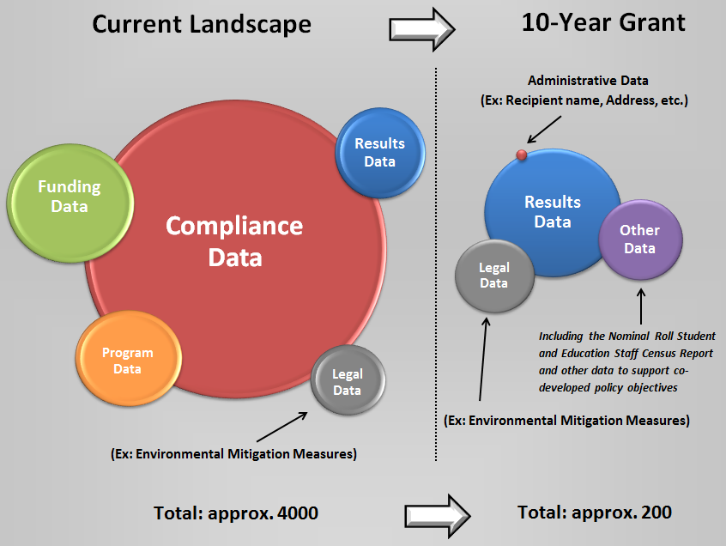
Reduced Reporting to ISC
Reduced administrative burden - 90% reduction in required data elements to focus accountability to First Nation citizens
The 10-Year Grant prioritizes accountability to First Nation Citizens including:
Annual reports and annual audited financial statements (pursuant to financial administration law/bylaw)
strategic and financial planning
Copies of the above documents would be shared with the department as a principle of mutual accountability.
Grant recipients will also be asked to provide data required to fulfil departmental reporting to Parliament.
Minimum Reporting under the 10-Year Grant

Slide 9
Supporting implementation of the 10-Year Grant
Strengthening mutual accountability and a nation-to-nation approach
The shift from program delivery compliance to collaborative approaches under the 10-Year Grant will be supported by annual meetings between representatives of the Council and ISC regional officials.
During these meetings First Nations will have the opportunity to discuss the implementation of the 10-Year Grant and the overall functioning of the fiscal relationship.
These meetings can include collaborative discussions on how to support First Nations in continuing to meet eligibility criteria for the 10 Year Grant and in achieving their goals and priorities set out in First Nations planning.

Slide 10
Next Steps – Eligible First Nations
Eligible First Nations – First Nations that meet the eligibility criteria will be notified and if they still wish to opt into the grant, a Funding agreement will be prepared.
Eligibility Criteria – First Nations will need to continue to meet the eligibility criteria throughout the term of the agreement, including the implementation of key provisions of their financial administration law or by-law.
Supports - First Nations will continue to have access to FMB-developed tools, as well as advice and support. First Nations can also work with the Board to access their services in order to work towards acquiring Financial Performance Certification and the Financial Management Systems Certification.
Strengthening governance – First Nations can access funding from the Professional and Institutional Development program. The program is administered at the regional level and funds projects that will benefit the capacity of communities to perform core governance functions.

Slide 11
Next Steps – First Nations working towards eligbility criteria
First Nations working towards meeting eligibility criteria can continue to work with FMB.
The Professional and Institutional Development Program - All First Nations interested in developing their governance capacity can submit a project proposal through the Professional and Institutional Development Program. The program funds projects that will benefit the capacity of communities to perform core governance functions, including working towards meeting eligibility criteria.
All First Nations are eligible for project-based funding under this Program, regardless of their interest in the 10-year Grant.

Slide 12
Summary of Roles and Responsibilities
 | Eligibility Criteria and Application | Implementation of Grants
First Nation Governments | Choose path for adopting FAL or FAB, if required Provide information to verify eligibility Work with ISC, FMB to obtain support as needed to meet eligibility criteria | Provide information to verify continued eligibility Inform ISC if they no longer meet eligibility criteria Work with ISC, FMB to obtain support needed to maintain eligibility, meet requirements of the agreement
Indigenous Services Canada | Issue final decisions on grant eligibility Coordinate information on grants, responses to questions from stakeholders Support First Nations during application process | Confirmation of authority to create grants Co-development of grant agreement model Information to First Nations to support grant implementation by April 2019 Delivery of grant funding arrangements Capacity supports, informed by regular dialogue between FN, ISC regional offices
First Nations Financial Management Board | Report to ISC on assessing against eligibility criteria Support First Nations during application process Co-development of eligibility criteria | Monitoring of eligibility criteria, financial performance trends Capacity support services Co-development partner
Assembly of First Nations | Co-development of eligibility criteria | Co-development partner

